Slide 1
Paddle of Theseus
Hidden Layer Design

Slide 2
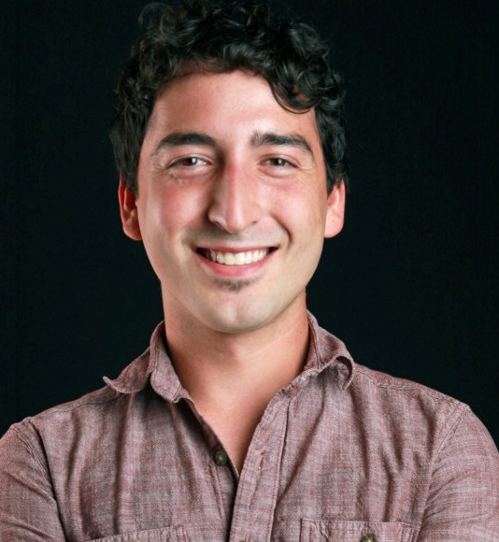
Introduction
Chase E. Stewart
design, electronics, software, prototyping
M.S. Embedded Sys. CU Boulder
Spencer Arrasmith
PCB & user interface consulting
Eric Atencio
Mechanical Design, Fabrication
M.S. Mech Eng. CU Boulder
Thanks to Luke Padilla, Patrick Mahony!

Slide 3
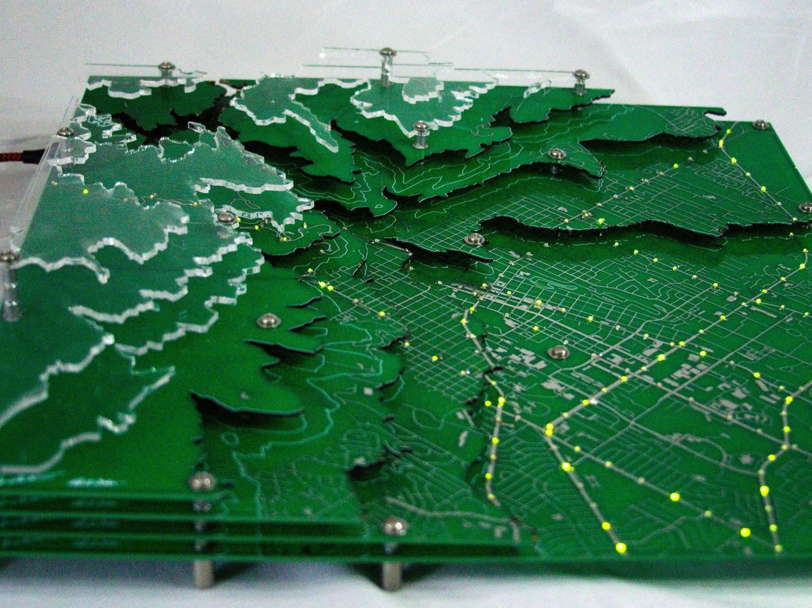
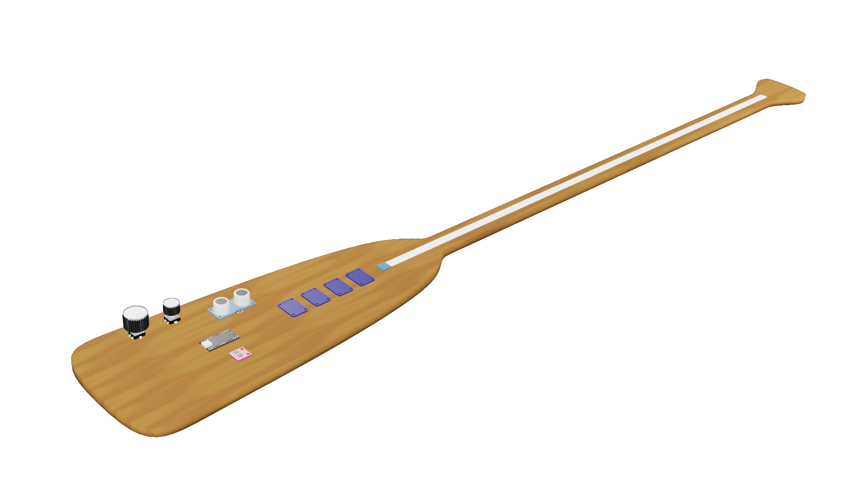
Hidden Layer Design
https://hiddenlayerdesign.com
empower artists to achieve demanding technological visions by providing high-tech consultation and creation of custom software and embedded electronic artifacts.
Hidden Layer: Boulder [2018], Paddle of Theseus [2021]

Slide 4
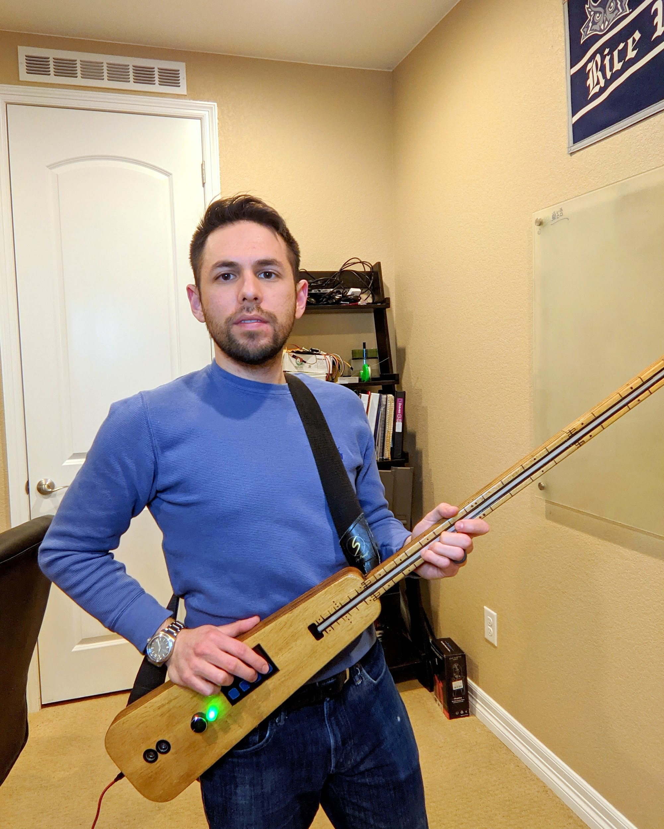
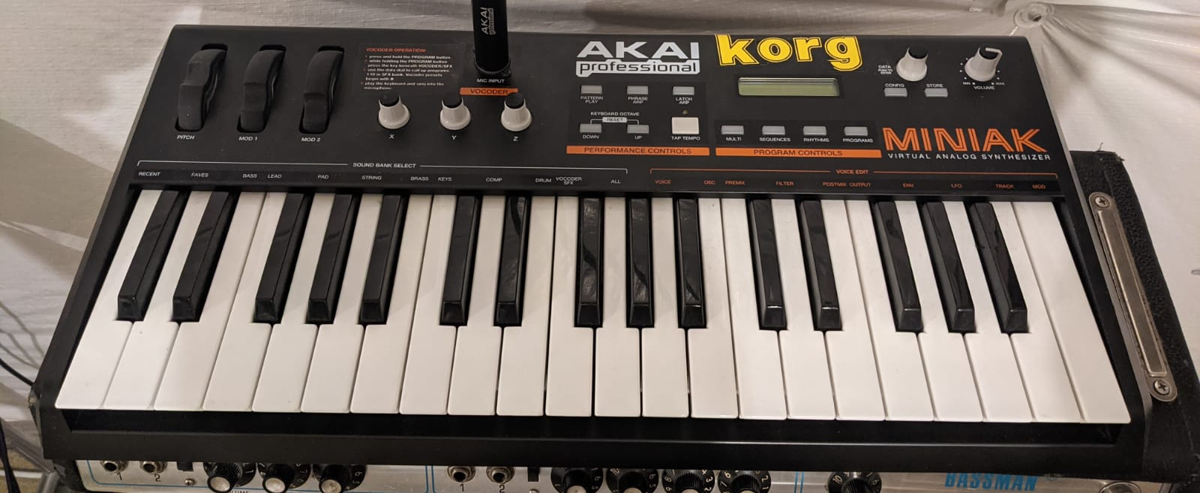
Project Statement
Digital Instrument, like electronic keyboard
Plays like a fretless bass w/ whammy bar
github.com/ChaseStewart/Paddle-of-Theseus

Slide 5
Demonstration
Hold down along the neck to “fret”
Tap a button to “strum”
Buttons together can form a chord
Wave hand to use “whammy bar”
Turn standard knob to change volume
Turn LED knob to change effect (setup required)
Tap LED knob to switch config

Slide 6
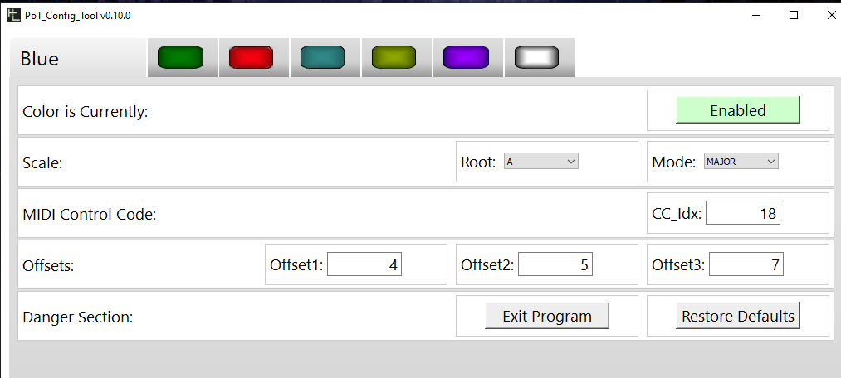
Configuration Mode/ Tool
Enter via Config Gesture, leave via “Exit Program” in PoTConfig tool
Settings persist until changed
See and change state
Root Note
Mode (Major, Minor, Mixolydian, Dorian, Chromatic)
LED knob control code
Button-note offsets
Restore Defaults
Enable/Disable Config

Slide 7
Goals
Expressive instrument one might choose to perform
Expressive- allows precision and controlled wide range of output
Easy to play and understand
Bring instrument fully to product
Use off-the-shelf sensors and build processes
Seamless left/right hand design

Slide 8
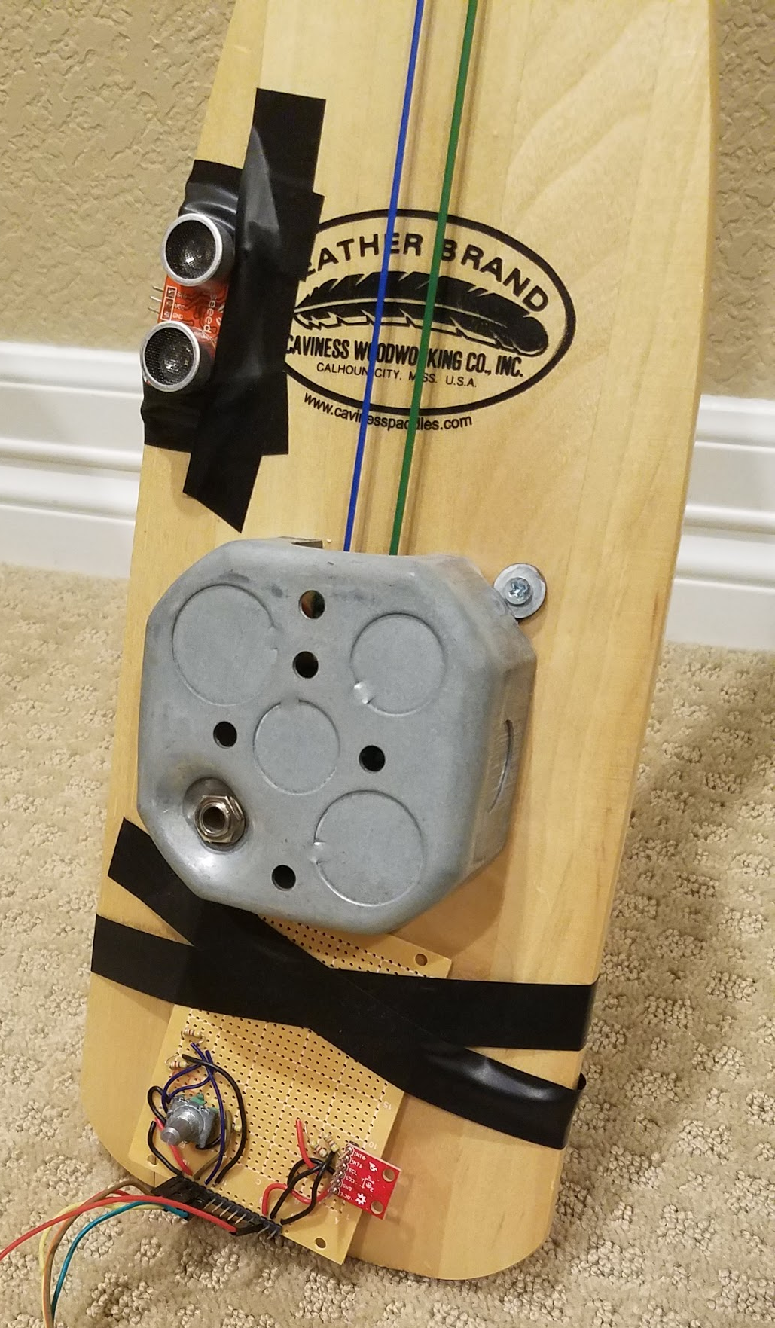
Roadmap
One prototype, ~5 sensor kits built
Everything built by hand
Software at v1.0
PoTConfig available at hiddenlayerdesign.com
Gauging interest in project
Track status on GitHub

Slide 9
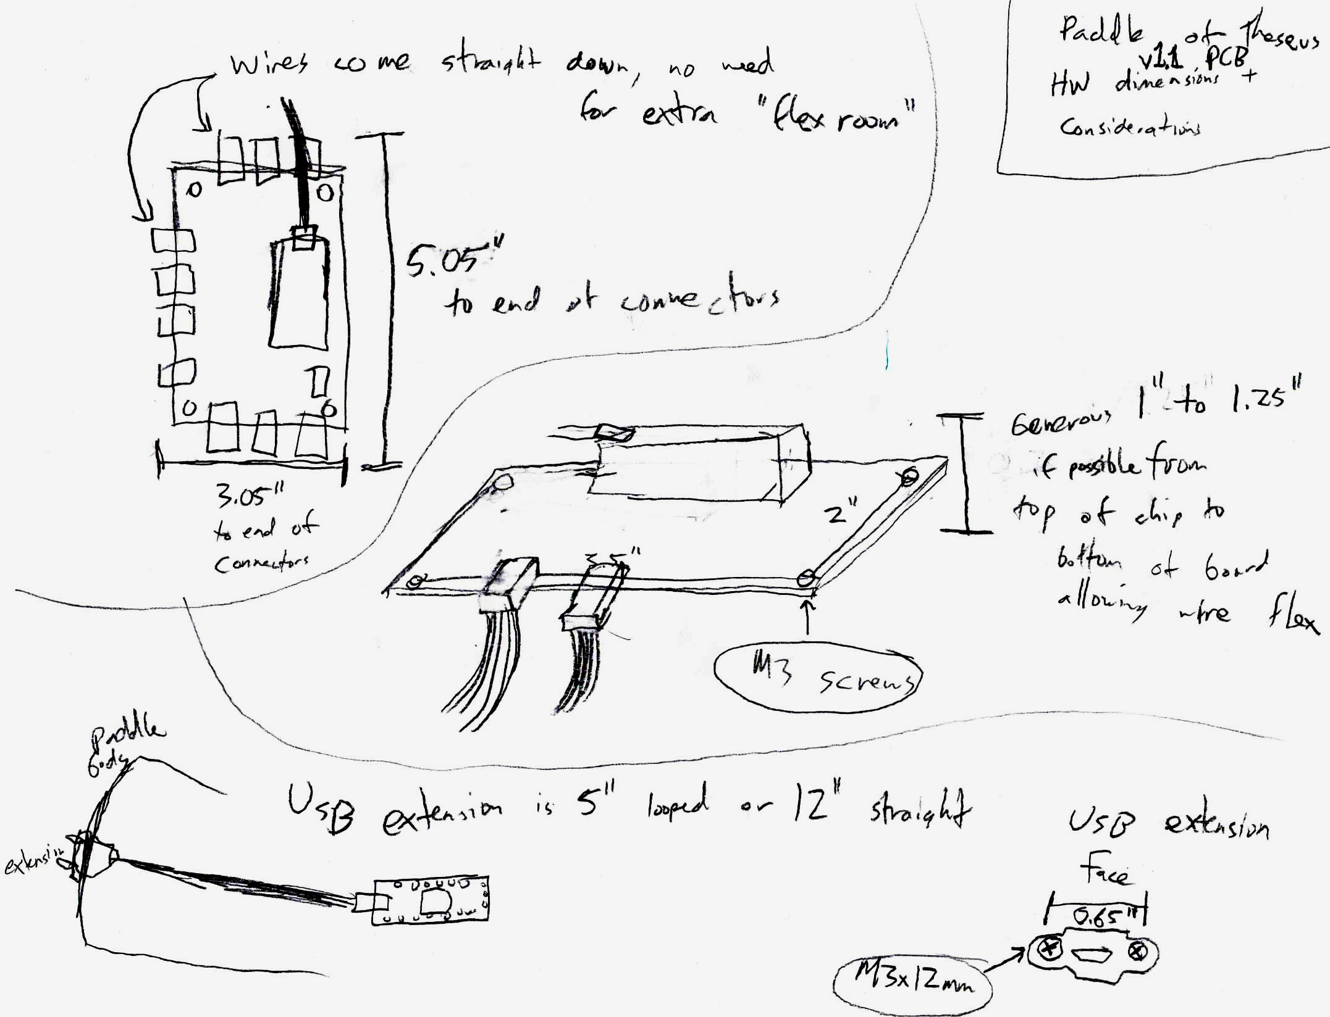
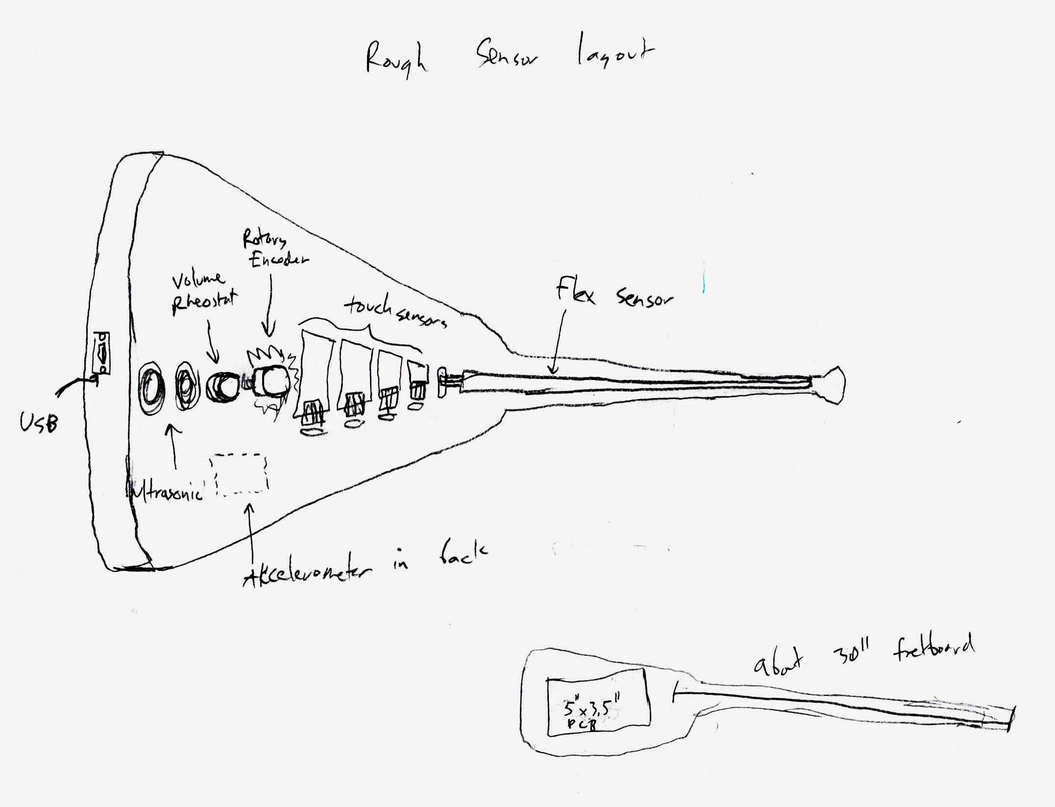
Thank You!
http://eepurl.com/hqUX0n

Slide 10
References

Slide 11
Tech Stack
Teensy LC with MIDI+Serial over USB
Written in Arduino and C++
Config mode menu is CLI served over USB serial in Arduino firmware
You can just use the CLI, you don’t need the PoTConfig program!
Custom PCB designed in Upverter
Config program is Python/PyQt5 with Fman Build System
Nonvolatile settings are stored in EEPROM (128B)
Connectors are MTA-640457 series, but then standard female header ends

Slide 12
Software Design
Sensor_readings + config_settings = MIDI messages
Init code: Config or normal mode?
Config Mode: start User Interface to configure nonvolatile memory
Normal Mode: load configs, infinitely loop reading sensors and sending MIDI
Built-in MIDI over USB- just connect to MIDI sink
This was a major reason I chose the Teensy
EEPROM memory-maps config structs into offsets for each config

Slide 13
MIDI
Technical standard for digital music [UMich Presentation on MIDI]
Create notes, some control over output sound
The Paddle is only a Source
no playback or sound capabilities of its own
Implements NoteOn, NoteOff, AfterTouch, PitchBend, wildcard of your choice
Playing with Teensy + MIDI can be really rewarding!!!

Slide 14
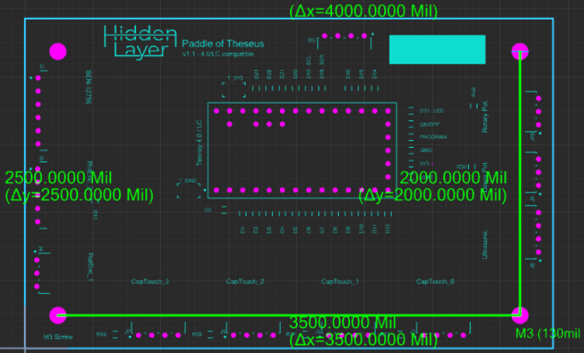
Custom PCB
Important for production, reliability
Not for every project!
Worth the cost
Worth spending time to get right
Assembly can be HARD
Wires+headers do same thing!
This one is mostly connectors

Slide 15
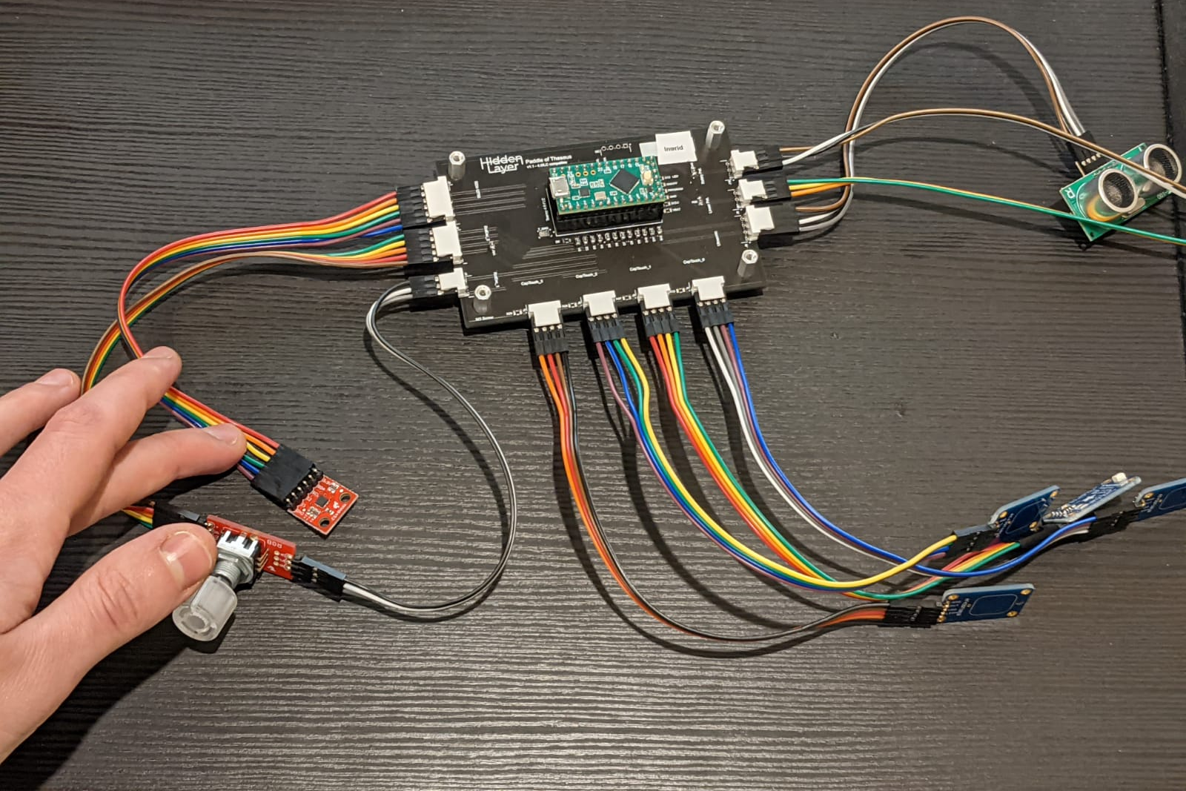
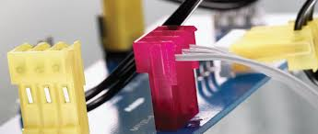
Prototype Assembly
Hand assembled/ hand soldered/ custom wires
MTA connectors into PCBs
Watch Wire Gauge when doing this
Goal is Reliability

Slide 16
GUI program
Fman Build System (FBS)/PyQt5 using Spencer’s PyQtSA library
QT GUI reads/ writes to CLI over USB serial
Settings are saved in EEPROM until changed
Available for Windows/Debian at hiddenlayerdesign.com
Won’t go to main screen without paddle serial

